Slide 1

PIERIAN CLOUD

Slide 2

Google Cloud Associate Cloud Engineer
Resources
Management & Monitoring

Slide 3
Google Cloud Associate Cloud Engineer
As you use more GCP services and resources, you want to make sure you have knowledge of the tools used to monitor your usage and manage your Google Cloud services.
This is a critical area to learn, since it directly connects with GCP costs!

Slide 4
Google Cloud Associate Cloud Engineer
Resource Management and Monitoring:
Resource Manager
Quotas and Limits
Label Key-Value Pairs
Billing and Budgets
GCP Console Billing Tour and Demos

Slide 5
Google Cloud Associate Cloud Engineer
Let’s get started!

Slide 6
Google Cloud Associate Cloud Engineer
Resource Manager

Slide 7
Google Cloud Associate Cloud Engineer
The Google Cloud Resource Manager:
cloud.google.com/resource-manager
The GCP Resource Manager is highly related to IAM Resource Hierarchy.
Let’s have a quick review of Resource Hierarchy…

Slide 8
Google Cloud Associate Cloud Engineer
ORG NODE
FOLDERS
PROJECTS
RESOURCES
ORG

Slide 9
Google Cloud Associate Cloud Engineer
ORG NODE
FOLDERS
PROJECTS
RESOURCES
ORG
IAM Policy Inheritance

Slide 10
Google Cloud Associate Cloud Engineer
ORG NODE
FOLDERS
PROJECTS
RESOURCES
ORG
IAM Policy Inheritance
Child policy can not restrict permissions granted at a higher parent policy level.

Slide 11
Google Cloud Associate Cloud Engineer
ORG NODE
FOLDERS
PROJECTS
RESOURCES
ORG
Resource Monitoring and Management

Slide 12
Google Cloud Associate Cloud Engineer
Resources can belong only to a single project.
ORG NODE
FOLDERS
PROJECTS
RESOURCES
ORG
Resource Monitoring and Management

Slide 13
Google Cloud Associate Cloud Engineer
Projects are connected to one billing account.
Resources can belong only to a single project.
ORG NODE
FOLDERS
PROJECTS
RESOURCES
ORG
Resource Monitoring and Management

Slide 14
Google Cloud Associate Cloud Engineer
Org contains all the billing accounts.
Projects are connected to one billing account.
Resources can belong only to a single project.
ORG NODE
FOLDERS
PROJECTS
RESOURCES
ORG
Resource Monitoring and Management

Slide 15
Google Cloud Associate Cloud Engineer
Since resources can only be associated with one (and only one) project, then each project contains the consumption of all the resources within it.

Slide 16
Google Cloud Associate Cloud Engineer
Project Resource Management:
Enable Billing
Manage Permissions
Enable Services
Recall that Projects can be identified via their Project Name, Project Number or Project ID.

Slide 17
Google Cloud Associate Cloud Engineer
Project Resource Management:
Each project has its own billing and usage reporting.

Slide 18
Google Cloud Associate Cloud Engineer
Review:
We’ve explored how every resource has to be associated with a single project, allowing us to perform resource management and billing at a project level.

Slide 19
Google Cloud Associate Cloud Engineer
Up Next:
Let’s learn more about Quotas and Limits.

Slide 20
Google Cloud Associate Cloud Engineer
Quotas

Slide 21
Google Cloud Associate Cloud Engineer
Resources inside a project will be subject to the project quotas (aka Limits).
Quick Note:
If the default quotas are not enough for you, it is possible to increase them through a support ticket or in the GCP Console.

Slide 22
Google Cloud Associate Cloud Engineer
Project Quota Use Cases:
Limit of how many resources per project.
Rate limit of API requests.
Amount of resources created per region.

Slide 23
Google Cloud Associate Cloud Engineer
Rate quotas are typically used for limiting the number of requests you can make to an API or service.
Rate quotas reset after a time interval that is specific to the service—for example, the number of API requests per day.

Slide 24
Google Cloud Associate Cloud Engineer
Allocation quotas are used to restrict the use of resources that don't have a rate of usage, such as the number of VMs used by your project at a given time.
Allocation quotas don't reset over time, instead you must explicitly release the resource when you no longer want to use it—for example, by deleting a GKE cluster.

Slide 25
Google Cloud Associate Cloud Engineer
Project quotas help prevent billing spikes and as the organization grows resource usage, it forces users to consider their usage goals.

Slide 26
Google Cloud Associate Cloud Engineer
Review:
We learned some basics about project quotas.

Slide 27
Google Cloud Associate Cloud Engineer
Up Next:
We will learn about labels which allow us to further organize GCP resources.

Slide 28
Google Cloud Associate Cloud Engineer
Label Key-Value Pairs

Slide 29
Google Cloud Associate Cloud Engineer
A label is a key-value pair that helps you organize your Google Cloud resources. You can attach a label to each resource, then filter the resources based on their labels.
Information about labels is forwarded to the billing system, so you can break down your billed charges by label.

Slide 30
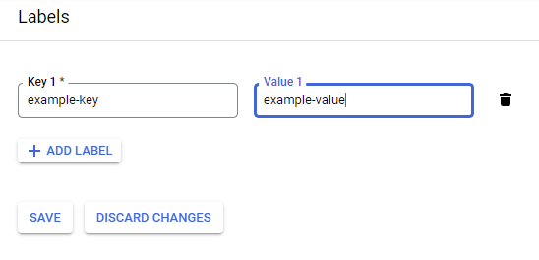
Google Cloud Associate Cloud Engineer
Labels are attached to resources:

Slide 31
Google Cloud Associate Cloud Engineer
What are some use cases for labels?

Slide 32
Google Cloud Associate Cloud Engineer
What are some use cases for labels?
Team or cost center labels:
Add labels based on team or cost center to distinguish resources owned by different teams (for example, team:research and team:analytics). You can use this type of label for cost accounting or budgeting.

Slide 33
Google Cloud Associate Cloud Engineer
What are some use cases for labels?
Component labels:
For example, component:redis, component:frontend, component:ingest, and component:dashboard.

Slide 34
Google Cloud Associate Cloud Engineer
What are some use cases for labels?
Environment or stage labels:
For example, environment:production and environment:test

Slide 35
Google Cloud Associate Cloud Engineer
What are some use cases for labels?
State labels:
For example, state:active, state:readytodelete, and state:archive.

Slide 36
Google Cloud Associate Cloud Engineer
What are some use cases for labels?
Virtual machine labels:
A label can be attached to a virtual machine.
Virtual machine tags that you defined in the past will appear as a label without a value.

Slide 37
Google Cloud Associate Cloud Engineer
The labels applied to a resource must meet the following requirements:
Each resource can have multiple labels, up to a maximum of 64.

Slide 38
Google Cloud Associate Cloud Engineer
The labels applied to a resource must meet the following requirements:
Each label must be a key-value pair.

Slide 39
Google Cloud Associate Cloud Engineer
The labels applied to a resource must meet the following requirements:
Keys have a minimum length of 1 character and a maximum length of 63 characters, and cannot be empty. Values can be empty, and have a maximum length of 63 characters.

Slide 40
Google Cloud Associate Cloud Engineer
The labels applied to a resource must meet the following requirements:
Keys and values can contain only lowercase letters, numeric characters, underscores, and dashes. All characters must use UTF-8 encoding, and international characters are allowed.

Slide 41
Google Cloud Associate Cloud Engineer
The labels applied to a resource must meet the following requirements:
The key portion of a label must be unique. However, you can use the same key with multiple resources.

Slide 42
Google Cloud Associate Cloud Engineer
The labels applied to a resource must meet the following requirements:
Keys must start with a lowercase letter or international character.

Slide 43
Google Cloud Associate Cloud Engineer
Review:
We learned about labels, why they are used and their requirements.
We also learned that labels can appear in billing information for filtering.

Slide 44
Google Cloud Associate Cloud Engineer
Up Next:
We will explore billing on GCP in more detail!

Slide 45
Google Cloud Associate Cloud Engineer
Billing and Budgets

Slide 46
Google Cloud Associate Cloud Engineer
One of the most important aspects of using Google Cloud is having a clear understanding of billing to prevent any surprises!
Cloud computing can often be experimental with unknown future usage, we’ll want safeguards in place.

Slide 47
Google Cloud Associate Cloud Engineer
The two main components of understanding costs on GCP:
Billing Report
Budgets

Slide 48
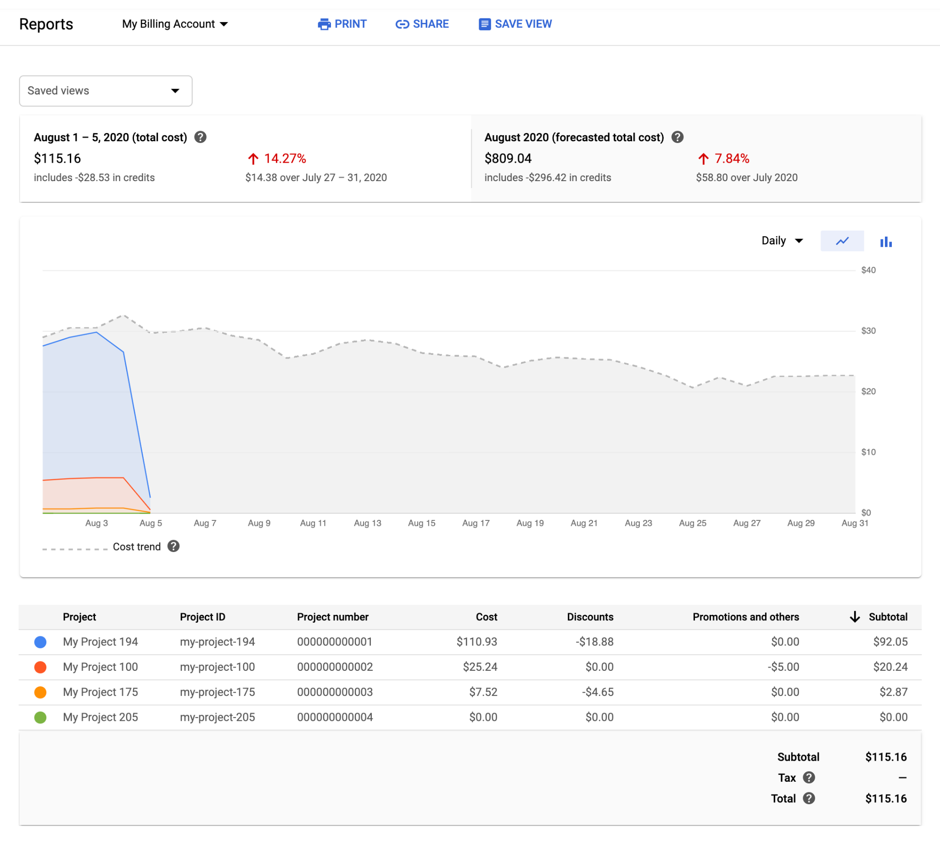
Google Cloud Associate Cloud Engineer
Billing Report

Slide 49
Google Cloud Associate Cloud Engineer
Billing Report
Total costs incurred.

Slide 50
Google Cloud Associate Cloud Engineer
Billing Report
Forecasted costs based on current usage.

Slide 51
Google Cloud Associate Cloud Engineer
Billing Report
Costs shown over time.
Each color represents a different GCP project.

Slide 52
Google Cloud Associate Cloud Engineer
Billing Report
Costs per project, including discounts or promotions.

Slide 53
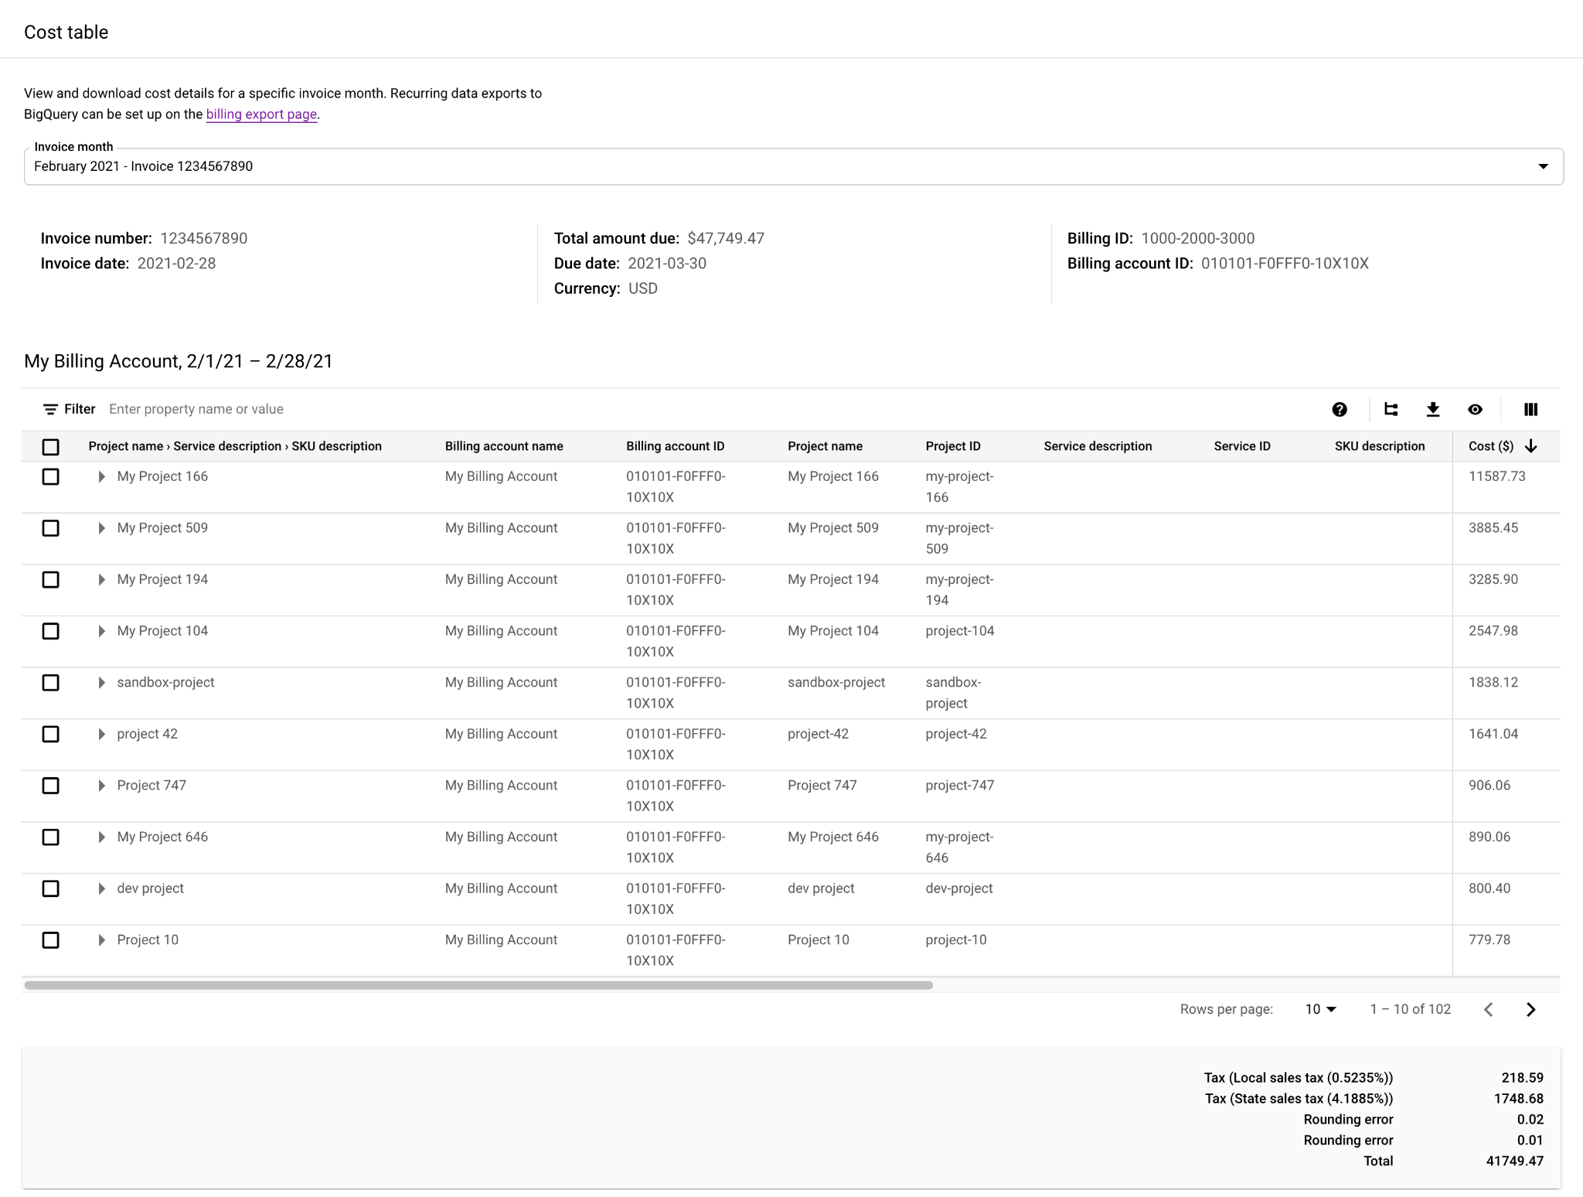
Google Cloud Associate Cloud Engineer
Cost Table
Further detailed view for invoice month

Slide 54
Google Cloud Associate Cloud Engineer
Cost Table
Includes additional details you might need, such as service IDs, SKU IDs, and project numbers.

Slide 55
Google Cloud Associate Cloud Engineer
While billing reports can inform you of past costs and forecasted future costs, we can use budgets to set alerts or automated actions based on spending limits being hit.

Slide 56
Google Cloud Associate Cloud Engineer
After you've set a budget amount, you set budget alert threshold rules that are used to trigger email notifications.
Budget alert emails help you stay informed about how your spend is tracking against your budget.
You can also use budgets to automate cost control responses.

Slide 57
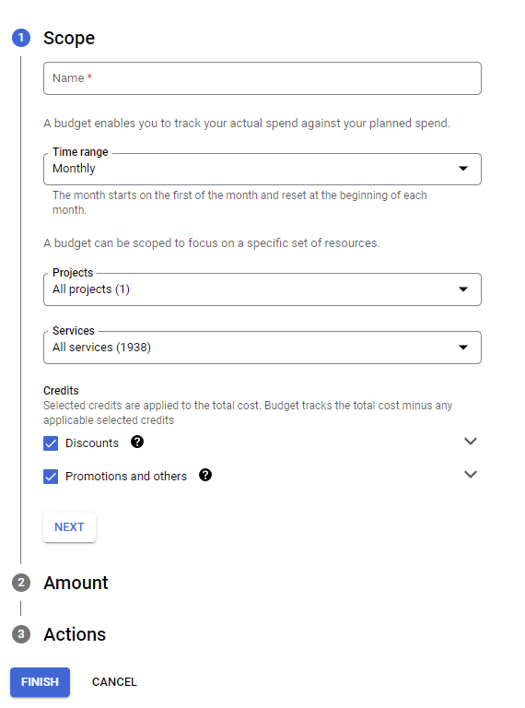
Google Cloud Associate Cloud Engineer
Budget Scope
Define time range and associated projects and services.

Slide 58
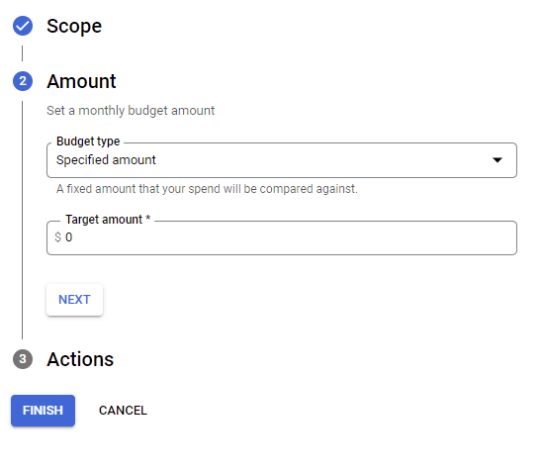
Google Cloud Associate Cloud Engineer
Budget Amount
Dollar amount for the budget or simply base it on historical spend.

Slide 59
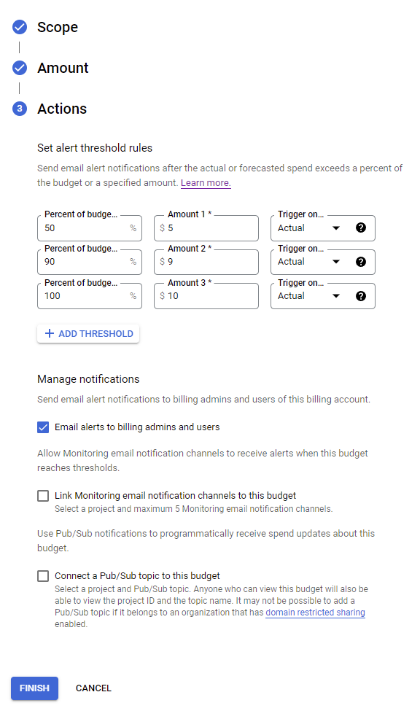
Google Cloud Associate Cloud Engineer
Budget Actions
Decide what happens when certain percentages of budget are hit.

Slide 60
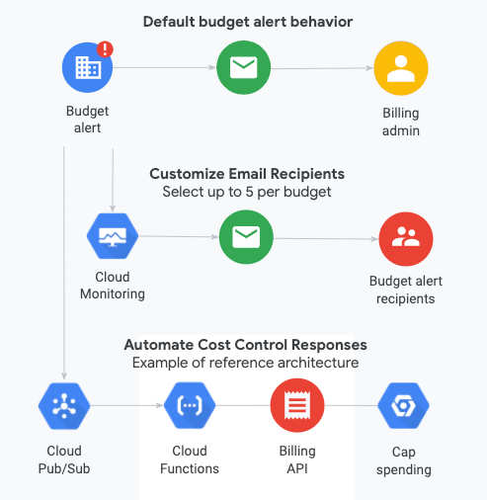
Google Cloud Associate Cloud Engineer
Budgets
GCP has default action alert behaviours that can easily be customized.

Slide 61
Google Cloud Associate Cloud Engineer
Review:
We’ve learned about billing reports, cost tables, and budget tools to help control, monitor, and manage our GCP costs.

Slide 62
Google Cloud Associate Cloud Engineer
Up Next:
Let’s dive into our GCP Console for a tour of the billing tools on Google Cloud!

Slide 63
Google Cloud Associate Cloud Engineer
DEMO:
GCP Billing Tour

Slide 64
Google Cloud Associate Cloud Engineer
DEMO:
GCP Budget

